Slide 1
Microcontroladores
M.C. Gabriel Casarrubias Guerrero

Slide 2
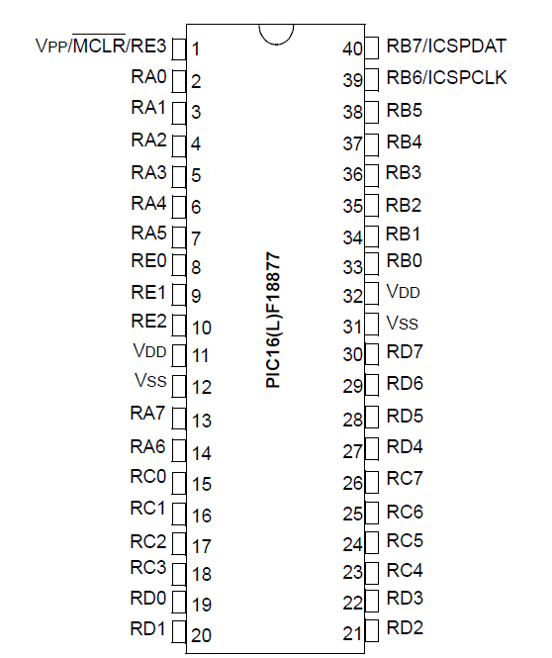
1.5.5 Distribución de terminales
Alimentación

Slide 3
Puertos I/O

Slide 4
¿Qué son los bits de configuración?
Son usados para configurar las caracteristicas del nucleo:
Code Protect
Watchdog Timer
Oscillator Options
Debug Options
More…
14-bit Program Memory
Vector de reset
Vector de interrupción
Flash de usuario
Memoria de usuario
Registro CONFIG está localizado en la memoria del programa, fuera del rango del espacio del código de ejecución.
Registros de configuración
Memoria de configuración
Device ID
Notes:
4
The configuration word, which is only accessible at programming time, is used to setup various options for the PICmicro, such as whether or not the Watchdog Timer should be enabled, what kind of oscillator will be used, and so on.

Slide 5
Ejemplo de palabra de configuración
CONFIG1 (Osciladores)
bit 13
bit 0
FCMEN
---
CSWEN
---
---
CLKOUTEN
---
RSTOCS2
RSTOCS1
RSTOSC0
---
FEXTOSC2
FEXTOSC1
FEXTOSC0
CONFIG2 (Supervisores)
bit 13
bit 0
DEBUG
STVREN
PPS1WAY
ZCDDIS
BORV
---
BOREN1
BOREN0
LPBOREN
---
---
---
PWRTE
MCLRE
CONFIG3 (Windowed WatchDog)
bit 13
bit 0
WTDCCS2
WTDCCS1
WTDCCS0
WTDCWS2
WTDCWS1
WTDCWS0
---
WDTE1
WDTE0
WDTCPS4
WDTCPS3
WDTCPS2
WDTCPS1
WDTCPS0
CONFIG4 (Memory)
bit 13
bit 0
LVP
SCANE
---
---
---
---
---
---
---
---
---
---
WRT1
WRT0
CONFIG5 (Code protection)
bit 13
bit 0
---
---
---
---
---
---
---
---
---
---
---
---
CPD
CP
Notes:
5
The configuration word, which is only accessible at programming time, is used to setup various options for the PICmicro, such as whether or not the Watchdog Timer should be enabled, what kind of oscillator will be used, and so on.

Slide 6
Características del reloj del sistema
XT
Cristal oscilador frecuencia estándar
100kHz - 4MHz
HS
Cristal oscilador de alta frecuencia
4MHz - 20MHz
LP
Cristal oscilador de baja frecuencia
5kHz - 200kHz
RC
Oscilador RC externo
DC - 4MHz
INTRC
Oscilador RC interno
4 o 8 MHz ± 2%
Opciones seleccionables del reloj proveen gran flexibilidad al diseñador:
LP Oscilador diseñado para el menor consumo de corriente
RC o INTRC provee una solución de ultra bajo costo de oscilador.
XT optimizado para las frecuencias de oscilador mas comúnmente usadas
HS optimizada para manejar cristales o resonadores de alta frecuencia

Slide 7
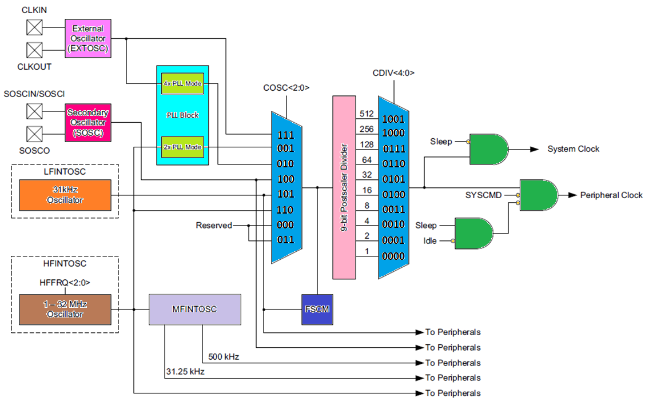

Slide 8
OSCILATOR CONTROL REGISTERS
Registro OSCCON1
Bit 7
Bit 0
U-0
R/W
R/W
R/W
R/W
R/W
R/W
R/W
---
NOSC2
NOSC1
NOSC0
NDIV3
NDIV2
NDIV1
NDIV0
NCDIV<3:0> CDIV<3:0> | Clock divider
1111-1010 | Reserved
1001 | 512
1000 | 256
0111 | 128
0110 | 64
0101 | 32
0100 | 16
0011 | 8
0010 | 4
0001 | 2
0000 | 1
NOSC<2:0> COSC<2:0> | Clock source
111 | EXTOSC
110 | HFINTOSC
101 | LFINTOSC
100 | SOSC
011 | Reserved
010 | EXTOSC with PLLx4
001 | HFINTOSC with PLLx2
000 | Reserved

Slide 9
1.5.6 El reset y sus posibles fuentes
Power-On Reset (POR)
Brown-out Reset (BOR)
MCLR Reset
WDT reset
Instrucción RESET
Stack overflow
Stack underflow
Programming mode exit

Slide 10
Windowed Watchdog Timer
Ayuda a recuperación de un mal funcionamiento de software
Usa su propio oscilador RC on-chip
WDT es limpiado por la instrucción CLRWDT
Una vez habilitado el WDT no puede ser deshabilitado por software
El desbordamiento del WDT resetea el chip
Periodo de tiempo programable:1ms a 250s
Opera en modo Sleep; cuando se cumple el tiempo, despierta el CPU
Tamaño de la ventana configurable de12.5 a 100 porciento de el periodo programado
Notes:
10
The primary purpose of the watchdog timer is to help the microcontroller recover from a software malfunction such as an infinite loop. As such, it cannot be disabled in software. Once it is enabled in the configuration word we saw earlier, it will be on forever and the only thing you can do is clear it via the CLRWDT instruction.
One very unique aspect of our WDT is that it runs from its own internal RC oscillator and is not dependent in any way on the system oscillator. Because the crystal is one of the most fragile components of the system, it can easily be shattered or disconnected, leaving the microcontroller without a clock source. Since the WDT runs independently, it can continue to run in the absence of a system clock and still reset the device into a known state. If your hardware is designed properly, you can take advantage of this fact to add some degree of hardware protection to your system.

Slide 11
Generación del reset interno
POR: Power On Reset
Con MCLR conectado a V_{DD}, un pulso de reset es generado cuando se detecta una subida en V_{DD}
PWRT: Power Up Timer
64 ms (nominal)
Desacoplado del BOR
OST: Oscillator Startup Timer
Mantiene en reset el dispositivo por 1024 ciclos
Permite que se estabilice el cristal o resonador.
Internal Reset
V_{DD}
On Chip Reset Circuit
MCLR
V_{DD}
MCLR
POR
T_{PWRT}
PWRT
T_{OST}
OST
Internal Reset
Reset
Execution
Notes:
11
The PICmicro offers a number of features that allow you to eliminate external circuitry that has traditionally been required with other microcontrollers.
Power on reset (POR) feature allows you to tie the MCLR (master clear) line to VDD without any additional components except perhaps a current limiting resistor. The necessary reset pulse will be automatically generated when a rise in Vdd is detected.
The Power Up Timer (PWRT) is used to prevent the PICmicro from starting up in an unstable state before the power supply has had a chance to ramp up and settle. The PWRT will hold the PICmicro in reset for about 72ms to ensure that in all but the most extreme cases, that the power supply has stabilized before the microcontroller is allowed to begin executing code.
The oscillator startup timer (OST) is automatically enabled for any oscillator mode except the RC modes. Its job is to ensure that the oscillator has enough time to stabilize in both amplitude and frequency before code begins executing to avoid any unpredictable behavior that can result from starting up with unstable conditions. The timer will hold the device in reset for 1024 cycles of whatever frequency the oscillator is running at.

Slide 12
Brown Out Reset (BOR)
Cuando el voltaje cae por debajo de un nivel particular, el dispositivo entra en reset
Previene una operación errónea o inesperada
Elimina la necesidad de un circuito externo de BOR
Notes:
12
There are two types of brown out protection available for the PICmicro, a standard fixed brown out that is triggered at around 4V, and a programmable brown out with several available trip points.
The brown out circuit monitors the supply voltage and if it drops below the threshold, the PICmicro is immediately put into reset mode to prevent erratic behavior where the voltage might be below the minimum Vdd parameter.
(Functional description on graphic slide 46)

Slide 13
Reset Brown Out Programable (PBOR)
Opciones de configuration(se ajustan al tiempo de programar)
No se puede habilitar / deshabilitar por software
Dos BV_{DD} puntos programables:
1.9V
1.8V
Notes:
13
The programmable BOR provides additional flexibility with 4 selectable trip points.

Slide 14
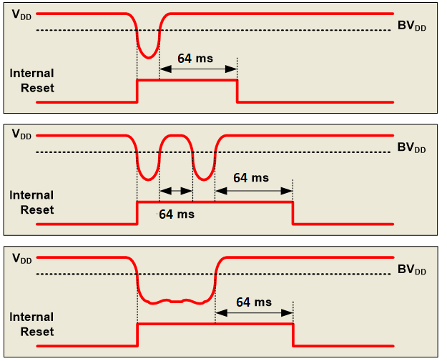
BOR Operation
Mantiene al MCU en reset hasta ~64ms despues de detectar el nivel adecuado en V_{DD}
Notes:
14
The brown out basically puts the part into reset whenever Vdd drops below the brown out threshold.
When the brown out condition ends, an internal RC timer starts and continues to hold the device in reset for 72ms before letting it run again. If another brown out occurs while the timer is counting, it will be reset.
The brown out module will hold the device in reset for as long as it takes as long as the voltage is high enough to keep it running.

Slide 15
Modo Sleep
El procesador puede ser puesto en un modo de bajo consume ejecutando la instrucción sleep
El Sistema del oscilador es parado
EL estatus del procesaor es mantenido
Watchdog timer sigue corriendo, si está habilitado
Corriente minima consumida (0.1 - 2.0μA)
Eventos que despiertan al procesador del modo sleep
MCLR
Master Clear Pin pulso bajo
WDT
Watchdog Timer Timeout
INT
Interrupción pin INT
TMR1
Interrupción Timer 1
ADC
Interrupción de conversion A/D completa
CMP
Interrupción por cambio en la salida del comparador
CCP
Evento de captura de entrada
PORTB
Interrupción por cambio eb el PORTB
SSP
Synchronous Serial Port (I²C Mode) Start / Stop Bit Detect Interrupt
Notes:
15
In today’s world of battery powered applications, low power modes are more critical than ever. All PICmicro devices provide a sleep mode in which the system oscillator is completely stopped, along with all peripherals dependent on that oscillator, such that the system is drawing little more than leakage current in the 0.1 to 2 microamp range.

Slide 16
Tarea
3.4 Características de la fuente de alimentación y consumo de corriente del microcontrolador

Slide 17
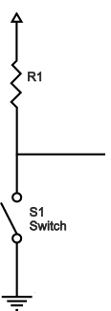
Funcionamiento básico
5v
0.1uF

Slide 18
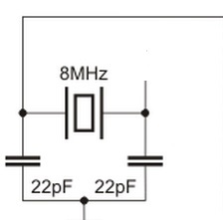
Funcionamiento básico
5v
0.1uF

Slide 19
Funcionamiento básico (programación)
5v
0.1uF

Slide 20
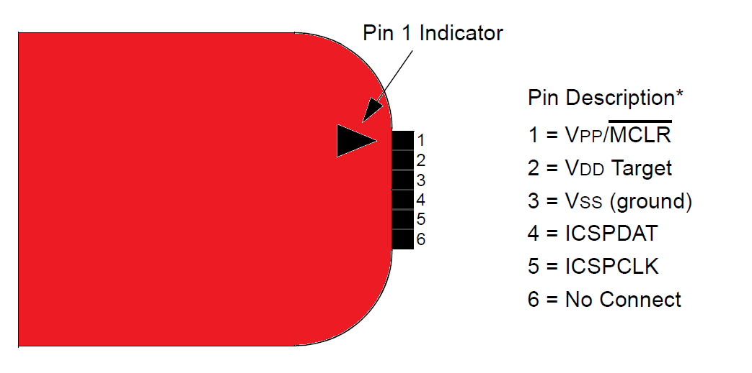
ICSP In-Circuit Serial Programming

